Slide 1

Components of computer
Компоненты компьютера

Slide 2
Purpose of the lesson
Presentations are communication tools that can be used as demonstrations.
to learn the nesessary vacabulary on the theme
Your Title Here
Presentation are communication tools that can be used as demontrations, lectures, reports, and more. it is mostly presented before an audience.

Slide 3
plan
01
02
03
Vacabulary
Reading
Crossword
04
05
06
Listening
Instruction
Translation

Slide 4
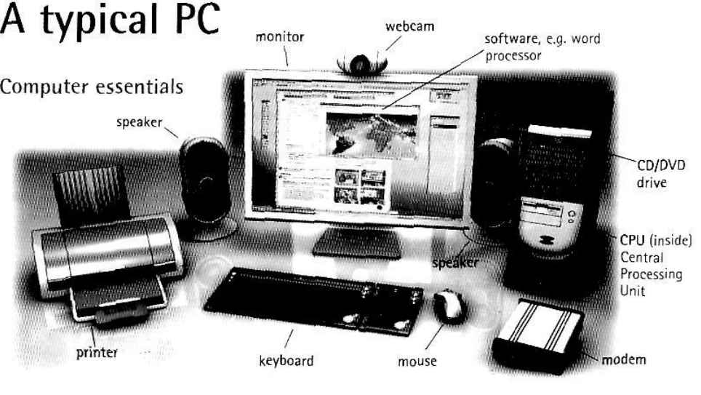
Vacabulary

Slide 5
Reading
The Computer Components are the necessary hardware units required to build a complete computing machine. Every computer must have these essential components to build a fully functional computing machine. This article explains the basic components of a computer in detail.
Basic Components of Computer
The essential components include the motherboard, input-output devices, CPU, RAM, and hard disk drives, all of which together process and store data. Although all these components can function individually, each tool must work in unity to produce accurate results.
Generally these components are classified according to their functional flow:
•Input unit
•Central Processing Unit
•Output unit
Motherboard (Main Board)
A motherboard is the most important Printed Circuit Board (PCB) that allows interaction between any critical electronic components of the entire system. These devices include the central processing unit and memory. It also provides connectors for other external devices. As the name of Printed Circuit Board suggests, we can also term this board as the mother of all the devices and components connected to it.
Presentations are communication tools that can be used as demonstrations.
Your Title Here
Presentation are communication tools that can be used as demontrations, lectures, reports, and more. it is mostly presented before an audience.

Slide 6
Reading
Motherboard (Main Board)
A motherboard is the most important Printed Circuit Board (PCB) that allows interaction between any critical electronic components of the entire system. These devices include the central processing unit and memory. It also provides connectors for other external devices. As the name of Printed Circuit Board suggests, we can also term this board as the mother of all the devices and components connected to it.
Input Unit
The input unit works as a fundamental part of the entire computer system. This process involves interaction with the user. These components can receive information directly from the user to command other devices. Many input devices perform specific functions depending on the type of input required to accomplish that particular task. Examples of input devices are a keyboard, mouse, joystick, etc.
•Keyboard: It consists of many keys, which we use to type any instruction. It helps us put commands on the computer system to perform our specific tasks. The device acts as a unit that allows the entire system to note the inputs implemented by the user.
•Mouse: Another commonly used input device acts as the computer's pointing and clicking device. It has a scrolling wheel to scroll on display and has some buttons for specific selection purposes.
•Joystick: This is an input device used primarily to give commands for the gaming process performed by the computer. We use this device to manage video games because it usually has more pushbuttons.
Presentations are communication tools that can be used as demonstrations.
Your Title Here
Presentation are communication tools that can be used as demontrations, lectures, reports, and more. it is mostly presented before an audience.

Slide 7
Reading
Output Unit
Output units are hardware devices attached to the computer that help the computer system interact with the user or other connected devices. It sends the processed data from the computer to the peripheral devices as per given commands. Most computer data output is in the form of audio and video. Thus, most of the output devices used by humans fall into these categories.
Some of the commonly used output devices are as follows:
•Monitor: A monitor is a hardware device that can efficiently display the data processed by the computer in a graphical output form. From monochrome monitors to color monitors and now coming to the latest LED/LCD; Thus, the technology for designing displays evolved.
•Speaker: Speaker is one of the most common output hardware devices used with computer systems to play the audio output generated by the sound card.
•Printer: A computer printer is an external hardware output device that can transfer electronic data from the computer to a hard copy; It can print text and graphics on paper or print 3D objects in the case of 3D printers.
essed data in a controlled format under instructions provided by system operators.
Presentations are communication tools that can be used as demonstrations.
Your Title Here
Presentation are communication tools that can be used as demontrations, lectures, reports, and more. it is mostly presented before an audience.

Slide 8
Reading
Central Processing Unit
The Central Processing Unit (CPU) is a processor, a primary component that performs most of the processing operations in a computer. It performs arithmetic, logic, and other operations to convert data inputs into more helpful information outputs and hence is also called the computer's brain.
It consists of three components: Memory Unit, Arithmetic & Logical Unit, and Control Unit.
•Memory Unit: This unit typically stores the processed data received from the input devices, providing the necessary space for managing computational activities.
•Arithmetic & Logical Unit: It is the major component of the CPU that deals with the appropriate operations and logical functions. In collaboration with other units, like any other device in the computer system, it uses the input data from the input device using the memory units for performing numerous jobs to obtain a faultless outcome.
•Control Unit: It is the major part of the Central Processing Unit. It receives input data from input devices and accomplishes the processed data in a controlled format under instructions provided by system operators.
Presentations are communication tools that can be used as demonstrations.
Your Title Here
Presentation are communication tools that can be used as demontrations, lectures, reports, and more. it is mostly presented before an audience.

Slide 9
Reading
Random Access Memory
The abbreviation for this term is RAM, the most regularly referred element in a computer system. It is known as the volatile memory, as stored information gets erased every single time when the power turns off. It helps store data regarding the applications that are often accessed programs and methods.
Hard Disk Drive
Hard Disk Drive (HDD) is an electromechanical data storage device used to store and retrieve data digitally using magnetic storage. HDD is a non-volatile data storage device, usually installed within a computer connected directly to the disk controller of the system's motherboard.
1.Solve a crossword in course on LearningApps.
Presentations are communication tools that can be used as demonstrations.
Your Title Here
Presentation are communication tools that can be used as demontrations, lectures, reports, and more. it is mostly presented before an audience.

Slide 10

Listening
Solve the task in LearningApps
Presentations are communication tools that can be used as demonstrations.
Your Title Here
Presentation are communication tools that can be used as demontrations, lectures, reports, and more. it is mostly presented before an audience.

Slide 11
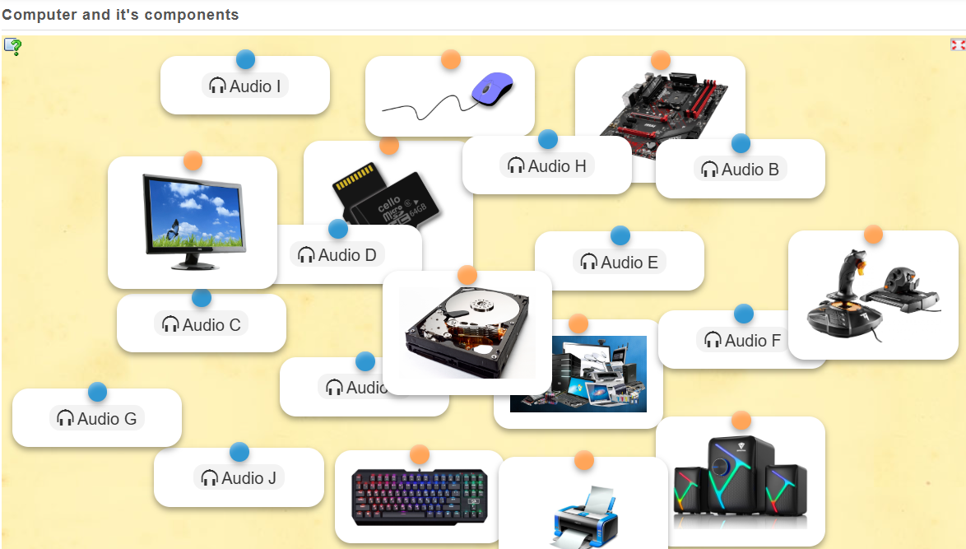
Listening
Presentations are communication tools that can be used as demonstrations.
Your Title Here
Presentation are communication tools that can be used as demontrations, lectures, reports, and more. it is mostly presented before an audience.

Slide 12

Crossword
Solve the task in LearningApps
Presentations are communication tools that can be used as demonstrations.
Your Title Here
Presentation are communication tools that can be used as demontrations, lectures, reports, and more. it is mostly presented before an audience.

Slide 13
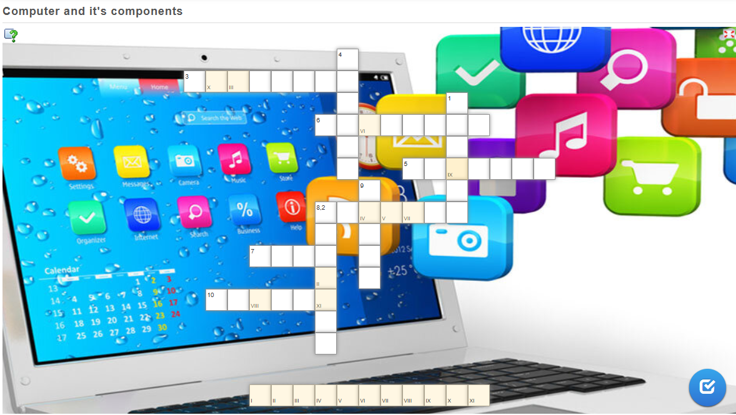
Crossword
Presentations are communication tools that can be used as demonstrations.
Your Title Here
Presentation are communication tools that can be used as demontrations, lectures, reports, and more. it is mostly presented before an audience.

Slide 14
Instruction
1. Check Components: Ensure you have all necessary components: CPU, motherboard, RAM, power supply, storage (HDD/SSD), GPU, and case.
2. Connect Cables: Connect all necessary power cables from the power supply to the motherboard, CPU, and GPU.
3. Connect Peripherals: Attach the monitor, mouse, keyboard, speakers, and printer to the appropriate ports.
4. Power On: Plug the power supply into a wall outlet and turn on the computer using the power button.
5. Check Functionality: Ensure the computer boots up properly and all peripherals are functioning. Check for any issues and troubleshoot if necessary.
Presentations are communication tools that can be used as demonstrations.
Your Title Here
Presentation are communication tools that can be used as demontrations, lectures, reports, and more. it is mostly presented before an audience.

Slide 15
Translation
1. Устройства ввода позволяют пользователю вводить данные в компьютер. К ним относятся клавиатура, мышь, сканеры и микрофоны.
2. Клавиатура используется для ввода текста и команд, а мышь позволяет управлять курсором на экране.
3. Сканеры преобразуют бумажные документы в цифровые файлы, а микрофоны позволяют записывать звук или передавать голосовые команды.
4. Устройства вывода отображают информацию пользователю. Наиболее распространённые из них – это мониторы и принтеры.
5. Мониторы выводят графическую информацию, позволяя пользователю видеть интерфейс и данные, а принтеры печатают изображения и тексты на бумаге.
6. Звуковые колонки и ушные телефоны также являются устройствами вывода, которые передают звуковую информацию.
7. Основные компоненты компьютера, такие как процессор, оперативная память и материнская плата, взаимодействуют с устройствами ввода и вывода, обеспечивая корректное выполнение задач.
Presentations are communication tools that can be used as demonstrations.
Your Title Here
Presentation are communication tools that can be used as demontrations, lectures, reports, and more. it is mostly presented before an audience.

Slide 16
Introspection
01
02
03
Vacabulary
Reading
Crossword
04
05
06
Listening
Instruction
Translation

Slide 17
THE END
Thanks for your work

